Slide 1
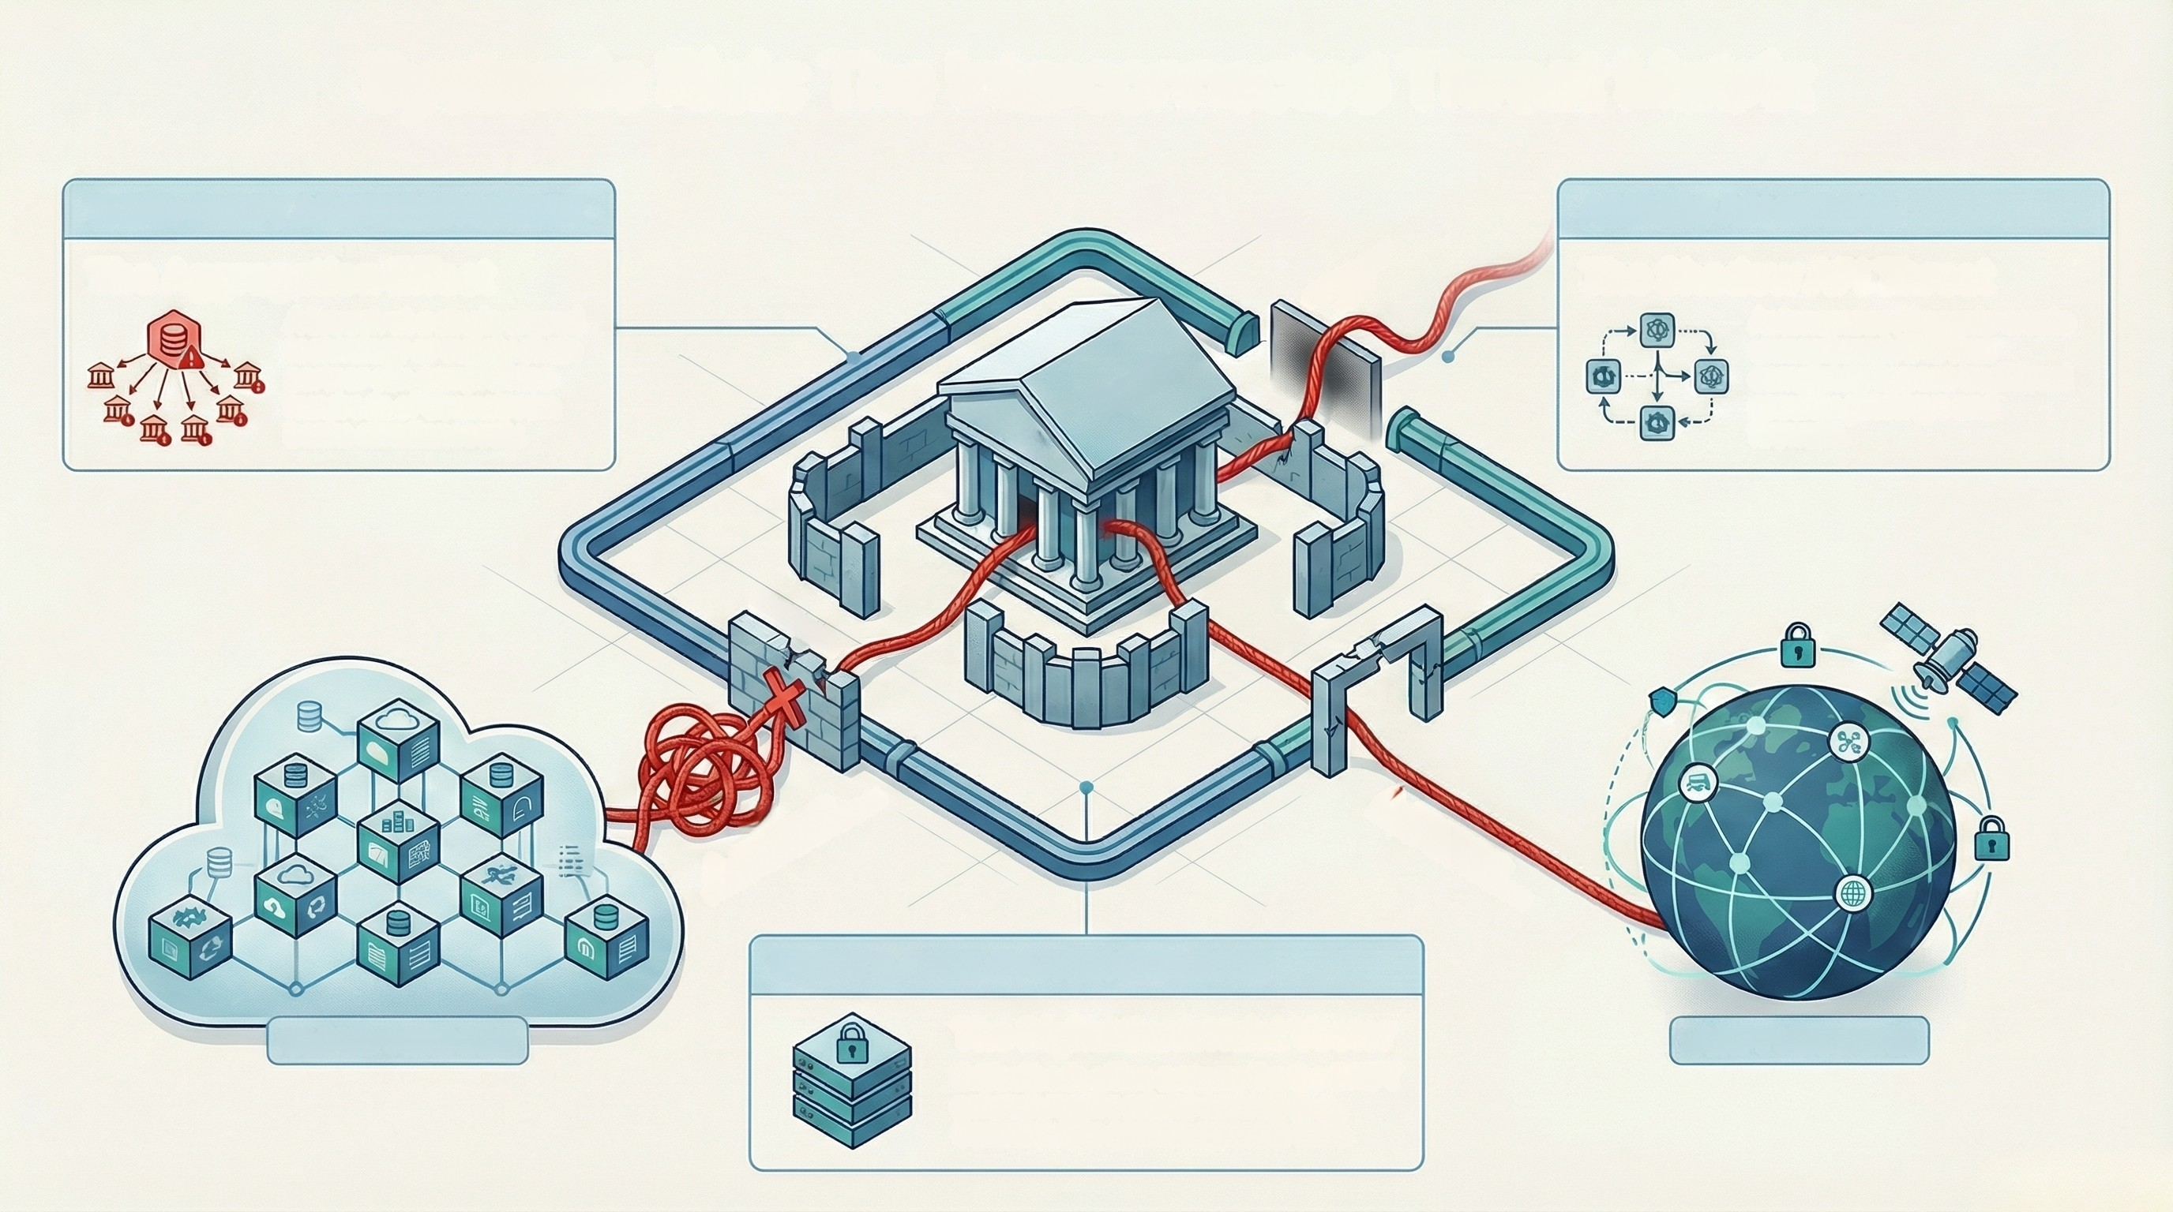
Systemic Risk: The Interconnected Threat Matrix
THIRD-PARTY AGGREGATION RISK
AGENTIC API SPRAWL
The Aggregation Effect
A breach at a single shared
technology or supply chain
partner can compromise
hundreds of downstream
banks simultaneously.
SHADOW
API
The Shadow API Threat
Autonomous Al agents create
unmonitored APIs that
completely bypass traditional
security gateways and
firewalls.
Bank
BANK
7
FIREWALL
▲ ATTACK PATH 1:
ATTACK PATH 2:
STRASS VIA CLOUD VEROO
GYMASS VIA SHADOW API
SWIFT & CORE SYSTEM EXPLOITS
CLOUD VENDORS
The Digital Bank Heist Vector
Critical back-office systems like the SWIFT
network require robust controls (e.g.,
Control 2.4) to prevent systemic theft.
SWIFT NETWORK

Slide 2
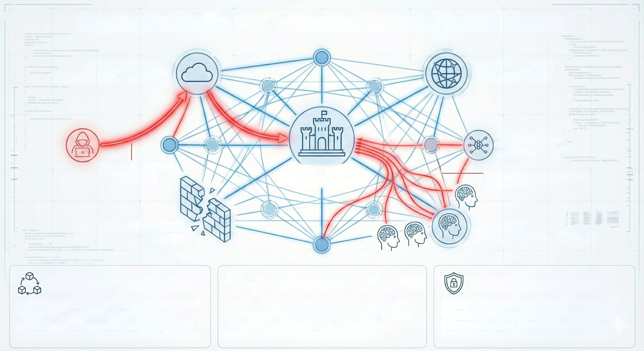
Systemic Risk: The Interconnected Threat Matrix
CLOUD VENDORS
(e.g., NightSpire, North Face)
SWIFT NETWORK
(Global Payments)
TRADITIONAL
API GATEWAY
Aggregation Effect
Attack Path
THE BANK
(Core Systems & Data)
Shadow APIs
(Unmonitored Ephemeral
Connections)
TRADITIONAL PERIMETER
FIREWALL
AI AGENTS
(Internal & External, Agentic Al)
2
THIRD-PARTY: Aggregation Effect
Supply web is non-linear. Breaching one critical
vendor (e.g., NightSpire IT management)
provides simultaneous access to hundreds of
downstream banks, bypassing direct defenses.
API SPRAWL: Agentic Al & Shadow APIs
Agentic Al autonomously generates ephemeral
connections. This creates unmonitored 'Shadow
APIs' that bypass gateways, acting as the
primary silent vector for data exfilitation.
SWIFT: Mandatory Control 2.4
Critical 2026 requirement to secure vulnerable
flows between the secure SWIFT zone and Back
Office applications. Essential to prevent 'bank
heist' scenarios and ensure network access.

Slide 3
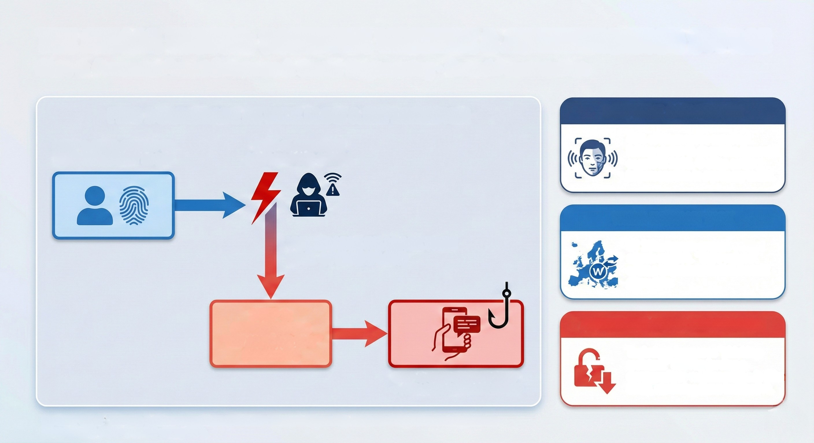
THE HUMAN VECTOR: COGNITIVE WARFARE & AUTHENTICATION BYPASS
Slide 8: Financial Fraud Schemes & Social Engineering - Board Presentation
FIDO DOWNGRADE ATTACK FLOW & EXPLOITATION
DEEPFAKE SATURATION
STEP 2: ATTACKER
JAMS/BLOCKS SIGNAL
43% of businesses reported
falling victim to deepfake financial
scams in 2025. C-suite audio
impersonation is a primary tactic.
STEP 1: USER ATTEMPTS
SECURE PASSKEY LOGIN
WERO INSTANT RISK
VULNERABLE FALLBACK PATH
(FAIL-OPEN EXPLOIT)
H1 2026 launch creates critical
attack surface. "Wero refund"
scams target irreversible instant
payments.
STEP 3:
SYSTEM OFFERS
"TRY ANOTHER WAY"
(FALLBACK)
AUTHENTICATION REGRESSION
Technique bypasses "phishing-
resistant" MFA by forcing a
downgrade to weaker methods (like
SMS), rendering them ineffective.
STEP 4: USER SELECTS "SMS"
-> ATTACKER INTERCEPTS OTP

